Slide 1
Turing Award Laureates
200320095 霍飞煌

Slide 2
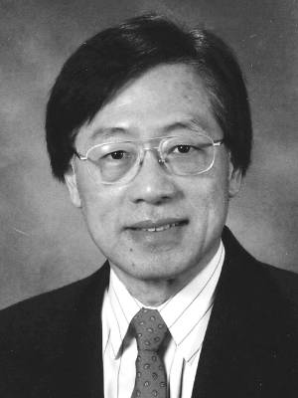
Andrew Yao(2000)
Andrew Yao(born December 24, 1946, Chinese) is a Chinese computer scientist and computational theorist. He is currently a Professor and the Dean of Institute for Interdisciplinary Information Sciences at Tsinghua University.
He received the Turing Award, the most prestigious award in computer science, in 2000, "in recognition of his fundamental contributions to the theory of computation, including the complexity-based theory of pseudorandom number generation, cryptography, and communication complexity".

Slide 3
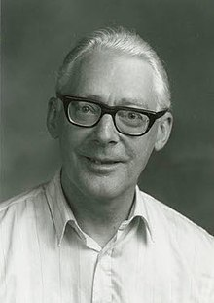
Ole-Johan Dahl(2001)
Ole-Johan Dahl(October 12, 1931, Norwegian, - June 29, 2002) was a Norwegian computer scientist. Dahl was a professor of computer science at the University of Oslo.
He is considered to be one of the fathers of Simula and object-oriented programming along with Kristen Nygaard. The object-oriented approach is now pervasive in modern software development, including widely used imperative programming languages such as C++ and Java. He received the Turing Award for his work in 2001 (with Kristen Nygaard).

Slide 4
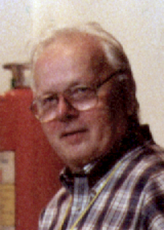
Kristen Nygaard(2001)
Kristen Nygaard(August 27, 1926, Norwegian, - August 10, 2002) was a Norwegian computer scientist, programming language pioneer, and politician.
Nygaard is acknowledged as the co-inventor of object-oriented programming and the programming language Simula with Ole-Johan Dahl in the 1960s. Nygaard and Dahl received the 2001 Turing Award for their contribution to computer science.

Slide 5
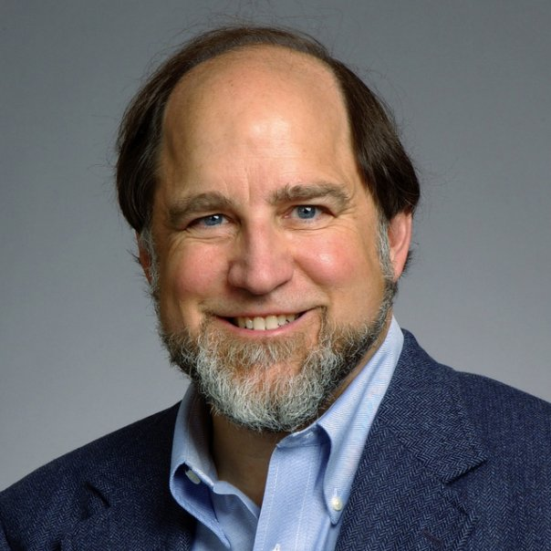
Ron Rivest(2002)
Ron Rivest(born May 6, 1947, American) is a cryptographer and an Institute Professor at MIT. His work has spanned the fields of algorithms and combinatorics, cryptography, machine learning, and election integrity.
Rivest is one of the inventors of the RSA algorithm (along with Adi Shamir and Len Adleman). He is the inventor of the symmetric key encryption algorithms RC2, RC4, RC5, and co-inventor of RC6. In 2002, together with Adi Shamir and Len Adleman, he won the Turing Award for outstanding contributions to the RSA encryption algorithm in public key cryptography.

Slide 6
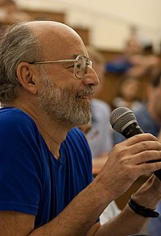
Adi Shamir(2002)
Adi Shamir(born July 6, 1952, Israeli) is a cryptographer. He is one of the founders of modern cryptography, and had made significant contributions to many of its branches. In 1977 he co-invented (together with Ron Rivest and Len Adleman) the RSA cryptosystem, which remains the best known and most commonly used public key encryption and signature scheme.
In 2002, together with Ron Rivest and Len Adleman, he won the Turing Award for outstanding contributions to the RSA encryption algorithm in public key cryptography.

Slide 7
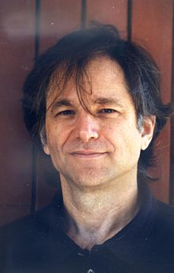
Leonard Adleman(2002)
Leonard Adleman, (born December 31, 1945, American), computer scientist and cowinner, with American computer scientist Ron Rivest and Israeli cryptographer Adi Shamir, of the 2002 A.M. Turing Award, the highest honour in computer science, for their “ingenious contribution for making public-key cryptography useful in practice.”
Adleman was elected a Fellow of the American Academy of Arts and Sciences in 2006.

Slide 8
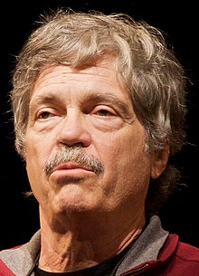
Alan Kay(2003)
Alan Kay, (born May 17, 1940, American), American computer scientist. Kay received a doctorate in computer science from the University of Utah in 1969. In 1972 he joined Xerox Corporation’s Palo Alto Research Center and continued work on the first object-oriented programming language (Smalltalk) for educational applications.
In 2003, he won the Turing Award for significant contributions to object-oriented programming languages, including Smalltalk.

Slide 9
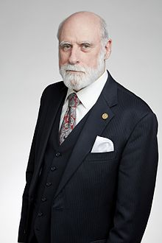
Vinton Cerf(2004)
Vint Cerf, (born June 23, 1943, American), American computer scientist who is considered one of the founders, along with Robert Kahn, of the Internet. In 1965 Cerf received a bachelor’s degree in mathematics from Stanford University in California.
In 2004 both Cerf and Kahn won the A.M. Turing Award, the highest honour in computer science, for their “pioneering work on internetworking, including the design and implementation of the Internet’s basic communications protocols, TCP/IP, and for inspired leadership in networking.”

Slide 10
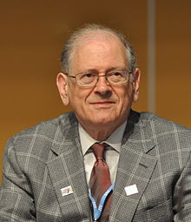
Bob Kahn(2004)
Bob Kahn(born December 23, 1938, American) is an American electrical engineer, who, along with Vint Cerf, first proposed the Transmission Control Protocol (TCP) and the Internet Protocol (IP), the fundamental communication protocols at the heart of the Internet.
In 2004, Kahn won the Turing Award with Vint Cerf for their work on TCP/IP.

Slide 11
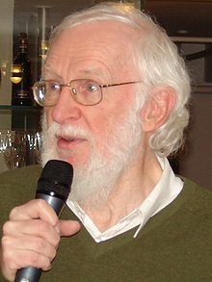
Peter Naur(2005)
Peter Naur(October 25, 1928, Danish – January 3, 2016), a great Danish scientist and the first Danish professor within Computer Science at University of Copenhagen 1969-1998, died 3 January 2016 after a short period of illness. He is best remembered as a contributor, with John Backus, to the Backus–Naur form (BNF) notation used in describing the syntax for most programming languages.
In 2005 Peter Naur received the most prestigious prize, the A. M. Turing Award, for his scientific contribution to Computer Science.

Slide 12
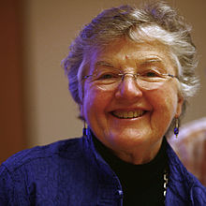
Frances Allen(2006)
Frances E. Allen, (August 4, 1932, American—August 4, 2020), American computer scientist who was the first woman to win the A.M. Turing Award (2006), the highest honour in computer science, cited for her “pioneering contributions to the theory and practice of optimizing compiler techniques that laid the foundation for modern optimizing compilers and automatic parallel execution.”
She worked for IBM from 1957 to 2002 and subsequently, was a Fellow Emerita.

Slide 13
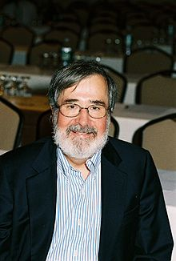
Edmund M. Clarke(2007)
Edmund M. Clarke, (July 27, 1945, American – December 22, 2020) was an American computer scientist and academic noted ally verifying hardware and software designs. He was the FORE Systems Profesfor developing model checking, a method for formsor of Computer Science Emeritus at Carnegie Mellon University. Clarke, along with E. Allen Emerson and Joseph Sifakis, was a recipient of the 2007 Association for Computing Machinery A.M. Turing Award.

Slide 14
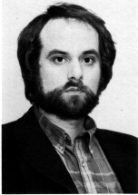
E. Allen Emerson(2007)
E. Allen Emerson, (born June 2, 1954, Dallas, Texas, U.S.), American computer scientist who was cowinner of the 2007 A.M. Turing Award, the highest honour in computer science, for “his role in developing Model-Checking into a highly effective verification technology, widely adopted in the hardware and software industries.” Emerson earned a bachelor’s degree (1976) in mathematics from the University of Texas and a doctorate (1981) in mathematics from Harvard University.

Slide 15
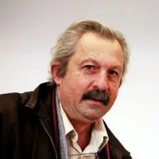
Joseph Sifakis(2007)
Joseph Sifakis (December 26, 1946, French) Greek-born French computer scientist. Sifakis is the founder of the Verimag laboratory in Grenoble, which is a leading research laboratory in the area of critical embedded systems.
He is recognized for his pioneering work on theoretical and practical aspects of concurrent systems specification and verification. In 2007 he received the Turing Award, which is seen as the ‘Nobel Prize” for Informatics/Computing.

Slide 16
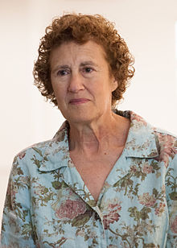
Barbara Liskov(2008)
Barbara Liskov (born November 7, 1939, American) is an American computer scientist who is an Institute Professor at the Massachusetts Institute of Technology and Ford Professor of Engineering in its School of Engineering's electrical engineering and computer science department.
She was one of the first women to be granted a doctorate in computer science in the United States and is a Turing Award winner who developed the Liskov substitution principle.

Slide 17
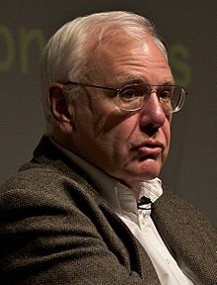
Charles P. Thacker(2009)
Charles Patrick (February 26, 1943, American – June 12, 2017) was an American pioneer computer designer. He designed the Xerox Alto, which is the first computer that used a mouse-driven graphical user interface (GUI).
Patrick is the winner of the 2009 A.M. Turing Award, the highest honour in computer science, for his “pioneering design and realization of the first modern personal computer.”

Slide 18
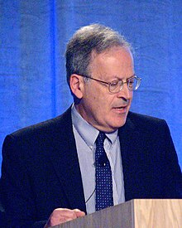
Leslie Valiant(2010)
Leslie Valiant, (born March 28, 1949, American.), Hungarian-born American computer scientist and winner of the 2010 A.M. Turing Award, the highest honour in computer science, “for his fundamental contributions to the development of computational learning theory and to the broader theory of computer science.”
He having been described by the A.C.M. as a heroic figure in theoretical computer science and a role model for his courage and creativity in addressing some of the deepest unsolved problems in science;

Slide 19
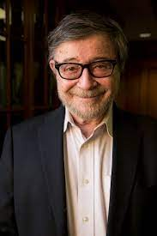
Judea Pearl(2011)
Judea Pearl (born September 4, 1936) is an Israeli-American computer scientist and philosopher, best known for championing the probabilistic approach to artificial intelligence and the development of Bayesian networks. He is also credited for developing a theory of causal and counterfactual inference based on structural models.
In 2011, ACM awarded Pearl with the Turing Award, the highest distinction in computer science, "for fundamental contributions to artificial intelligence through the development of a calculus for probabilistic and causal reasoning".

Slide 20
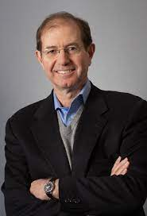
Silvio Micali(2012)
Silvio Micali (born October 13, 1954, Italian) is an Italian computer scientist at MIT Computer Science and Artificial Intelligence Laboratory and a professor of computer science in MIT's Department of Electrical Engineering and Computer Science since 1983. His research centers on the theory of cryptography and information security.
Micali won the Turing Award together with Shafi Goldwasser in 2012.

Slide 21
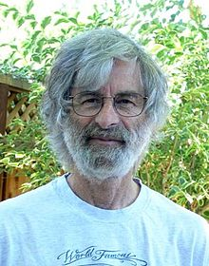
Leslie Lamport(2013)
Leslie B. Lamport (born February 7, 1941) is an American computer scientist. Lamport is best known for his seminal work in distributed systems, and as the initial developer of the document preparation system LaTeX and the author of its first manual.
Leslie Lamport was the winner of the 2013 Turing Award for imposing clear, well-defined coherence on the seemingly chaotic behavior of distributed computing systems, in which several autonomous computers communicate with each other by passing messages.

Slide 22
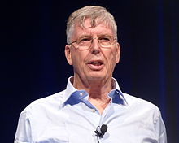
Michael Stonebraker(2014)
Michael Ralph Stonebraker (born October 11, 1943) is a computer scientist specializing in database research. Through a series of academic prototypes and commercial startups, Stonebraker's research and products are central to many relational database systems. He is also the founder of many database companies, including Ingres Corporation, Illustra, Paradigm4.
He won 2014 Turing Award, often described as "the Nobel Prize for computing.

Slide 23
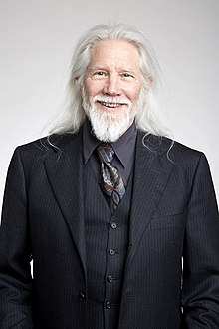
Whitfield Diffie(2015)
Whitfield Diffie (born June 5, 1944) is best known for discovering the concept of public key cryptography, which underlies the security of internet commerce and all modern secure communication systems. He is a Consulting Scholar in the Center for International Security and Cooperation at Stanford and a Visiting Professor at Royal Holloway College of the University of London.
In 2015, He won the Turing Award for outstanding contributions to the RSA encryption algorithm in public key cryptography.

Slide 24
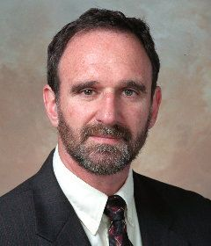
Martin Hellman(2015)
Martin Edward Hellman (born October 2, 1945) is an American cryptologist, best known for his invention of public key cryptography in cooperation with Whitfield Diffie and Ralph Merkle. Hellman is a longtime contributor to the computer privacy debate, has applied risk analysis to a potential failure of nuclear deterrence.
In 2015, He won the Turing Award for outstanding contributions to the RSA encryption algorithm in public key cryptography.

Slide 25
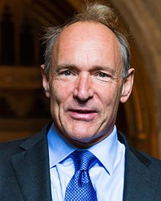
Tim Berners-Lee(2016)
Tim Berners-Lee, (born June 8, 1955, London, England), British computer scientist, generally credited as the inventor of the World Wide Web. In 2004 he was awarded a knighthood by Queen Elizabeth II of the United Kingdom and the inaugural Millennium Technology Prize (€1 million) by the Finnish Technology Award Foundation.
He received the 2016 Turing Award "for inventing the World Wide Web, the first web browser, and the fundamental protocols and algorithms allowing the Web to scale".

Slide 26
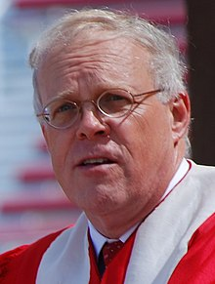
John L. Hennessy(2017)
John Leroy Hennessy (born September 22, 1952) is an American computer scientist, academician and businessman who serves as chairman of Alphabet Inc. Hennessy is one of the founders of MIPS Computer Systems Inc. as well as Atheros and served as the tenth President of Stanford University.
Along with David Patterson, Hennessy was a recipient of the 2017 Turing Award for their work in developing the reduced instruction set computer (RISC) architecture, which is now used in 99% of new computer chips.

Slide 27
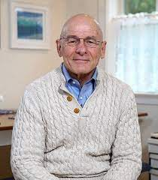
David Patterson(2017)
David Andrew Patterson (born November 16, 1947) is an American computer pioneer and academic who has held the position of professor of computer science at the University of California, Berkeley since 1976. He currently is vice chair of the board of directors of the RISC-V Foundation, and the Pardee Professor of Computer Science, Emeritus at UC Berkeley.
Hennessy and Patterson won the 2017 Turing Award for their work in developing RISC.

Slide 28
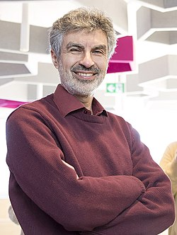
Yoshua Bengio(2018)
Yoshua Bengio (born March 5, 1964, Canadian) is a Canadian computer scientist, most noted for his work on artificial neural networks and deep learning. He is a professor at the Department of Computer Science and Operations Research at the Université de Montréal and scientific director of the Montreal Institute for Learning Algorithms (MILA).
Bengio received the 2018 ACM A.M. Turing Award, together with Geoffrey Hinton and Yann LeCun, for their work in deep learning.

Slide 29
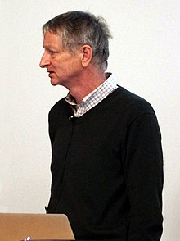
Geoffrey Hinton(2018)
Geoffrey Everest Hinton (born 6 December 1947) is a British-Canadian cognitive psychologist and computer scientist, most noted for his work on artificial neural networks. Since 2013, he has divided his time working for Google (Google Brain) and the University of Toronto. In 2017, he co-founded and became the Chief Scientific Advisor of the Vector Institute in Toronto.
Hinton received the 2018 Turing Award, together with Yoshua Bengio and Yann LeCun, for their work on deep learning.

Slide 30
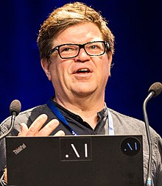
Yann LeCun(2018)
Yann André LeCun (born July 8, 1960) is a French computer scientist working primarily in the fields of machine learning, computer vision, mobile robotics, and computational neuroscience. He is the Silver Professor of the Courant Institute of Mathematical Sciences at New York University, and Vice President, Chief AI Scientist at Facebook.
LeCun received the 2018 Turing Award, together with Yoshua Bengio and Geoffrey Hinton, for their work on deep learning.

Slide 31
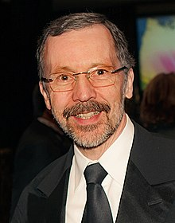
Edwin Catmull(2019)
Edwin Earl (born March 31, 1945) is an American computer scientist who was co-founder of Pixar and president of Walt Disney Animation Studios. In 2009, Catmull was awarded the Gordon E. Sawyer award from the Academy of Motion Picture Arts and Sciences for his lifetime contributions to computer graphics used in the motion picture industry.
He has been honored for his contributions to 3D computer graphics, including the 2019 ACM Turing Award.

Slide 32
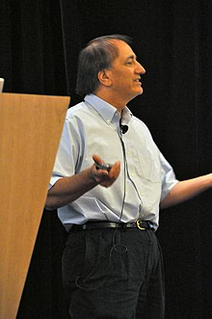
Pat Hanrahan(2019)
Patrick M. Hanrahan (born 1954) is an American computer graphics researcher, the Canon USA Professor of Computer Science and Electrical Engineering in the Computer Graphics Laboratory at Stanford University. His research focuses on rendering algorithms, graphics processing units, as well as scientific illustration and visualization. He has received numerous awards, including the 2019 Turing Award.

Slide 33
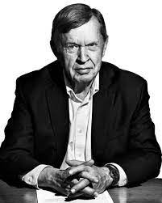
Alfred Aho(2020)
Alfred Vaino Aho (born August 9, 1941) is a Canadian computer scientist best known for his work on programming languages, compilers, and related algorithms, and his textbooks on the art and science of computer programming.
He and his long-time collaborator Jeffrey Ullman are the recipients of the 2020 Turing Award, generally recognized as the highest distinction in computer science.

Slide 34
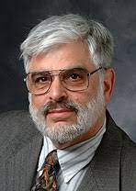
Jeffrey Ullman(2020)
Jeffrey David Ullman (born November 22, 1942) is an American computer scientist and the Stanford W. Ascherman Professor of Engineering, Emeritus, at Stanford University. His textbooks on compilers (various editions are popularly known as the green dragon book), theory of computation (also known as the Cinderella book), data structures, and databases are regarded as standards in their fields. He and his long-time collaborator Alfred Aho are the recipients of the 2020 Turing Award, generally recognized as the highest distinction in computer science.

